Slide 1
Regression Metrics Intuition
Shilpa

Slide 2
Metrics as a distance measure
y-axis
(2, 7)
Distance: d(z, y)
(6, 7)
Point z: (z1, z2)
Point y: (y1, y2)
Distance: d(x, y)
Distance: d(x, z)
(8, 4)
Point x: (x1, x2)
Set
x-axis

Slide 3
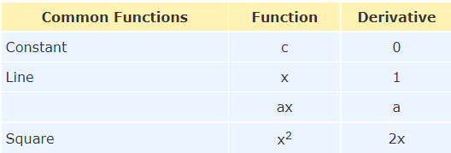
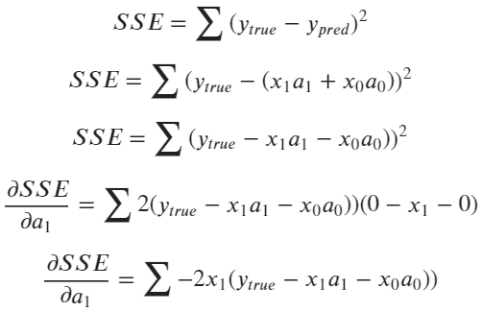
SSE as a Loss function
Substitute for y_pred
Source: https://www.mathsisfun.com/calculus/derivatives-rules.html
Expanding further:
(2x + 1)² → derivative w.r.t. x →
2 (2x + 1) (2 + 0) → 4 (2x + 1)
Derivative

Slide 4
Euclidean distance
We can extrapolate the same concept to N-dimensional space when we are dealing with vectors with N elements in our machine learning process.
y-axis
(2, 7)
Set
Point y: (y1, y2)
Distance: d(x, y)
4 - 7 = - 3
(8, 4)
8 - 2 = 6
Point x: (x1, x2)
Pythagorean Theorem:
d(x, y) = sqrt (6² + (-3)²)
x-axis

